Slide 1
Course: MOBI8001 - Mobile Technology and Cloud Computing
Period: March 2017
Trust in Mobile Cloud Computing
Session 13
D5627 – I Gede Putra Kusuma Negara, B.Eng., PhD

Slide 2
Outline
Introduction
Trust Properties
Components of Trust
Types of Trust
Trust Issues
Ways of Trust Establishment
Trust Evaluation
Detailed Study of Various Aspects of Trust in MCC
Conclusion
Bina Nusantara University

Slide 3
Introduction
Trust means firm belief in the reliability, goodness, honesty, effectiveness, faithfulness, or ability of someone or something.
We trust a system that we know thoroughly and that behaves according to our expectation.
In MCC, trust is a vital parameter because in this case personal data storage and data processing
occur remotely within the long-distance cloud.
Cloud Service Providers (CSPs) must evaluate and encourage trustworthy customers as well as remove malicious customers from the system.
A trustworthy relationship is a must between the CSPs and the cloud consumers for the effective worldwide deployment of MCC.
Bina Nusantara University

Slide 4
Trust Properties
Some important properties of trust:
Trust is field specific.
In mathematical sense, trust is not symmetric.
Trust is not transitive.
Trust may change dynamically.
Trust is a probabilistic value about an entity
Trust is multidimensional.
Trust is personal belief in some entity.
Bina Nusantara University

Slide 5
Components of Trust
Components of Trust:
Security makes it difficult or uneconomical for an unauthorized person or hacker to access confidential information or resources.
Privacy techniques protect against leakage or exposure of personal data.
Auditability is the ability to evaluate an organization, system, process, project, or product.
Accountability guarantees that all operations carried out by individuals, systems, or processes can be uniquely identified and that the trace to the author and the operation is kept
Bina Nusantara University

Slide 6
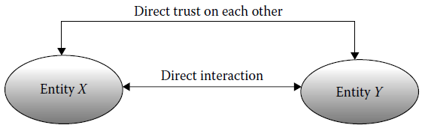
Types of Trust
Broadly, there are three types of trust:
  direct trust,
  indirect trust,
  hybrid trust.
Direct trust:
Bina Nusantara University

Slide 7
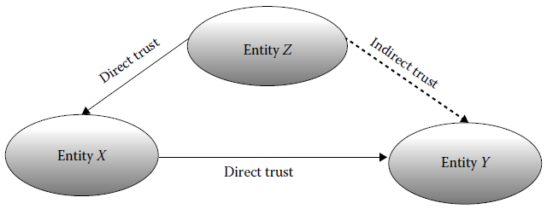
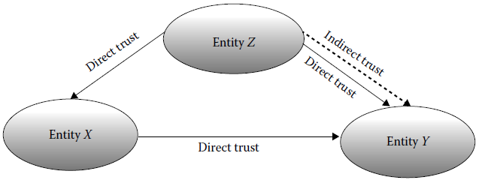
Types of Trust
Indirect
trust:
Hybrid
trust:
Bina Nusantara University

Slide 8
Trust Issues
Issues related to trust:
Weak Chain of Trust:
  Subcontractors may be present between the CSP and the customer.
  They may even contract others, whose identity, reputation, and trustworthiness cannot always be checked.
  Customers may not know all the subcontractors or even they may be totally unaware of the service chain.
  This produces a weak chain of trust.
Bina Nusantara University

Slide 9
Trust Issues
Issues related to trust:
Lack of Control and Visibility:
  Customers do not know who will process their personal information and whether their data will be adequately protected in the cloud.
  This lack of control and visibility produces distrust, and ultimately customers will keep themselves outside the cloud domain, especially when sensitive information is involved.
Bina Nusantara University

Slide 10
Ways of Trust Establishment
Approaches to identify trustworthy CSPs:
Service-Level Agreement
SLAs state what exactly the CSP can provide, what the features are, what security mechanism is applied, which assurances are actually met, etc.
Audit
Many audit standards are available and different CSPs use different audit standards, for example: FISMA, SAS70 II, ISO 27001. This assures cloud consumers about their offered services.
Measuring and Rating
The CSPs are rated based on a questionnaire filled by the current cloud consumers through a cloud marketplace (e.g. Spot Cloud)
Bina Nusantara University

Slide 11
Ways of Trust Establishment
Approaches to identify trustworthy CSPs:
Self-Assessment Questionnaire
The Cloud Security Alliance has provided a questionnaire for ensuring security features of CSPs, called the Consensus Assessments Initiative Questionnaire (CAIQ).
Trust and Reputation Model
This model has some parameters known as QoS+ parameters, such as SLA, compliance, portability, geographical location, customer support, performance, security measures, etc., to support customers in selecting the most appropriate cloud providers before actually interacting with them.
Bina Nusantara University

Slide 12
Trust Evaluation
The trust model is mainly concerned with trust representation, trust measurement, and trust evaluation.
Trust evaluation is the core of the trust model.
Ways to evaluate trust:
  Black Box Approach: the trustworthiness of an entity is evaluated by considering only the observed output; no knowledge about the internal architecture of the system or service is required.
  Inside-Out Approach: the trustworthiness of an entity is evaluated by considering the internal architecture of the system and trustworthiness of its subsystems.
  Outside-In Approach: the trustworthiness of an entity is evaluated based on the knowledge of the internal architecture of its components as well as the observed behavior of the overall service.
Bina Nusantara University

Slide 13
Detailed Study of Various Aspects of Trust in MCC
User Behavior Trust
CSPs must evaluate the trustworthiness of users by analyzing user behavior, in order to provide services more reliably to genuine users and to eliminate malicious users from their domain.
Evaluation principles of user behavior trust:
  Trust value attenuates over time.
  Recent behavior plays an important role in trust evaluation.
  The user behavior trust evaluation is based on a large number of historical behaviors of the user.
  The trust value should increase slowly.
  At the time of finding cheating behavior, reduced trust value has greater importance than that gradually increased.
Bina Nusantara University

Slide 14
Detailed Study of Various Aspects of Trust in MCC
User Behavior Trust
CSPs must evaluate the trustworthiness of users by analyzing user behavior, in order to provide services more reliably to genuine users and to eliminate malicious users from their domain.
Evaluation principles of user behavior trust:
  Trust value attenuates over time.
  Recent behavior plays an important role in trust evaluation.
  The user behavior trust evaluation is based on a large number of historical behaviors of the user.
  The trust value should increase slowly.
  At the time of finding cheating behavior, reduced trust value has greater importance than that gradually increased.
Bina Nusantara University

Slide 15
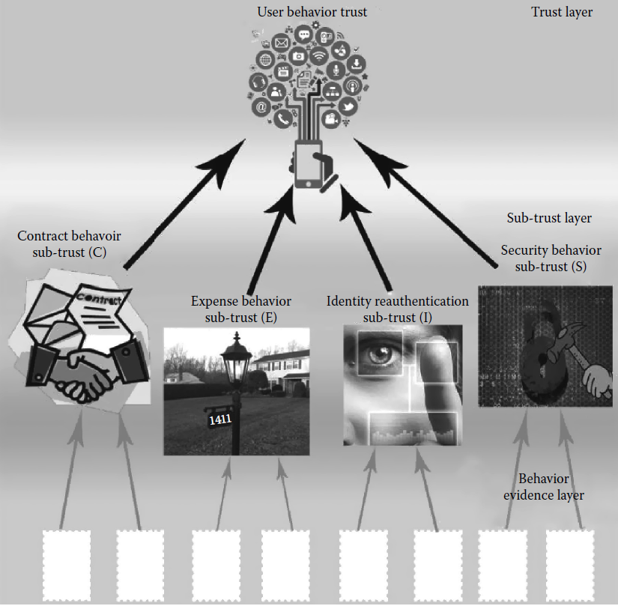
Detailed Study of Various Aspects of Trust in MCC
Hierarchy of user behavior trust evaluation:
Bina Nusantara University

Slide 16
Detailed Study of Various Aspects of Trust in MCC
Categories of user behavior trust:
  Contract behavior sub-trust: user compliance with the legal agreement between CSPs and cloud consumers.
  Security behavior sub-trust: user tendency to attack the CSP infrastructure.
  Identity reauthentication sub-trust: user reauthentication due to device lost or some abnormal activities.
  Expense behavior sub-trust: user behavior in using the cloud resources.
Bina Nusantara University

Slide 17
Detailed Study of Various Aspects of Trust in MCC
Methods of obtaining true and reliable trust evidences:
  Network flow detection tool.
  Invasion detection system
  Log and audit trails, such as system log, application log, auditing record.
  Data collecting tools
  Network management software, such as Cisco Works Software
  Specialized hardware, such as NetScout
  Security products, such as firewalls, access control system.
Bina Nusantara University

Slide 18
Detailed Study of Various Aspects of Trust in MCC
Other studies of trust in MCC:
  Trustworthy Mobile Sensing Framework
  Mobile Agent-Based Trustworthy Infrastructure for MCC
  Building Trustworthy Social Network Based on Call Behavior
  Trust-Based Mobile Commerce
Bina Nusantara University

Slide 19
Conclusion
The evaluation of cloud service provider’s trustworthiness is important with respect to cloud users.
It helps customers to choose between a number of CSPs and also to access cloud services without any question of data security hazard in their mind.
The Evaluation of the trustworthiness of the user behavior is essential to CSPs.
It helps the CSPs to encourage actual users and remove malicious users from the system.
Bina Nusantara University

Slide 20
References
Debashis De. (2015). Mobile Cloud Computing: Architectures, Algorithms and Applications. 01. Chapman and Hall/CRC Press. Florida. ISBN: 9781482242836. Taylor & Francis Publishing ISBN- 978–0–203–88776–9
R. K. L. Ko, P. Jagadpramana, M. Mowbray, S. Pearson, M. Kirchberg, Q. Liang, and B. S. Lee, TrustCloud: A framework for accountability and trust in cloud computing, in IEEE World Congress on Services, Washington, DC, pp. 584–588, 2011.
J. Golbeck, Computing with trust: Definition, properties, and algorithms, in IEEE Securecomm and Workshops, Baltimore, MD, pp. 1–7, 2006.
A. K. Singh, Trust and trust management models for ecommerce & sensor network, International Journal of Engineering Research and Applications, 2(6), 585–619, 2012.
K. Govindan and P. Mohapatra, Trust computations and trust dynamics in mobile ad hoc networks: A survey, IEEE Communications Surveys & Tutorials, 14(2), 279–298, 2012.
S. Pearson and A. Benameur, Privacy, security and trust issues arising from cloud computing, in Second IEEE International Conference on Cloud Computing Technology and Science, Indianapolis, IN, pp. 693–702, 2010.
S. M. Habib, S. Hauke, S. Ries, and M. Muhlhauser, Trust as a facilitator in cloud computing: A survey, Springer Journal of Cloud Computing, 1(1), 1–18, 2012.
Bina Nusantara University

